Slide 1

DEPARTMENT OF COMPUTER SCIENCE AND ENGINEERING
A Decentralized based approach for microfinance using blockchain technology
Under the guidance of
K.RANJITH REDDY
By
K. SHIVANI (197R1A05E3)
S. SHASHANK (197R1A05G6)
T.V. RAGHURAMSATHWIK (197R1A05H4)

Slide 2
Abstract
Small business owners often get exploited by moneylenders when borrowing money. High and unfair rates of interest, middlemen, and a process where the entire power lies in the hands of the lender leaves the borrowers vulnerable to exploitation. The entire process is very slow, and requires a lot of manual work.
We propose a solution to this problem through our DApp Decentralised Financial Peer to Peer Lender based on blockchain technology built on ethereum.

Slide 3
EXISTING SYSTEM:
To promote the financial development of underdeveloped countries, people who require financial assistance should be provided with financial services. But there is a misconnection at the core of banking: banks couldn’t lend to people without fixed income or collateral.
The geographical distance was cited by Hinson as the primary barrier stopping the poor from using traditional banking services.
To tackle this problem, microcredit came up as the solution. Microcredit, also known as micro banking or microfinance, provides credit to unconventional borrowers, such as the underprivileged, typically in the form of small loans with no collateral.
Grameen Bank gives the loan to the group based on the repayment credibility of the few people from that group who were given loans on the first attempt.
The global microfinance industry is quickly catching up with technological improvements in the financial sector.

Slide 4
DISADVANTAGES:
So, when authorities started storing data in the database, they couldn’t find the data concerning the many loans.
One reason may be the mismanagement amongst the lenders and borrowers having few mandatory documents.
And many times, borrowers fail to secure a loan due to a lack of trust due to no proper availability of documentation.
Additionally, the sector hires representatives who could not be deemed reliable, wasting time and resources.
Thus, making the loan-granting process time-consuming and untraceable.

Slide 5
PROPOSED SYSTEM:
The proposed lending model eliminates the middle parties like banks in the loan management process. It decreases the time taken to a great extent. Using Blockchain will ensure that no one will default on their transaction. Lenders can gain more interest rates for their invested money than banks. Borrowers can gain low-interest rates for the money borrow compared with banks.
The proposed decentralized KYC model eliminates human interaction in the process of KYC verification to a great extent. It restricts the submission of one’s documents in multiple organizations, with a high risk of data bleaching if any of those organizations compromise the security systems. There will be only one database to store the documents so they will be maintained with high-security standards. As every transaction will be held in Blockchain and are highly resistant to modification, neither of the parties can default any transaction.

Slide 6
ADVANTAGES OF PROPOSED SYSTEM:
The microfinance application framework (Micro chain) uses blockchain technology to ensure trust, transparency, privacy, and security, reducing fraudulent activities and increasing productivity in the microfinance industry.
The microcredit business is crucial in the fight against poverty, especially in underdeveloped nations.
There is preliminary evidence that blockchain technology can help with social, political, and economic concerns.
Concerns about trust are a hurdle for NGOs and borrowers in the microcredit system. More works talk about the infusion of technology and microfinance, paving more paths for the upliftment of the underprivileged segment fusion.

Slide 7
Hardware Requirements
System : Intel core i3(Minimum).
Hard Disk : 1 TB.
Monitor : 14’ Color Monitor.
Mouse : Optical Mouse.
Ram : 8 GB.
Software Requirements
Operating system : Any Operating System.
Coding Language : Solidity, JavaScript.
Front-End : HTML, CSS, JavaScript.
Data-Base : Blockchain.

Slide 8
NOVELTY:
The proposed lending model eliminates the middle parties like banks in the loan process. It decreases the time taken to a great extent.
The proposed decentralized KYC model eliminates a lot of human interaction in the process of KYC verification. It restricts the submission of one's documents in multiple organizations, which has a high risk of data bleaching if those organizations compromise the security systems
As every transaction will be stored in a blockchain and are resistant to modification, neither of the parties can default on any transaction.

Slide 9
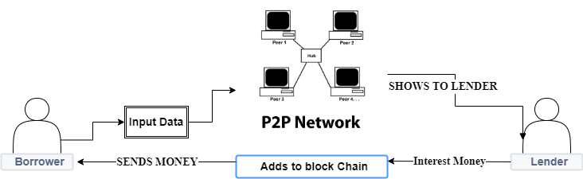
PROJECT ARCHITECTURE

Slide 10
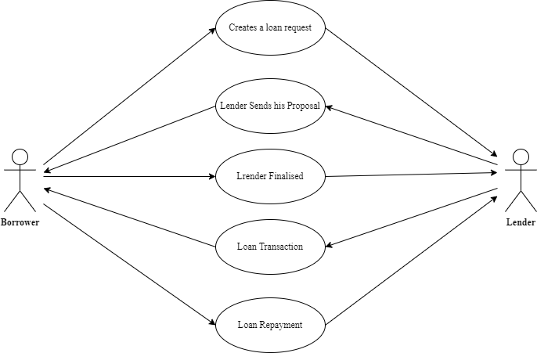
USE CASE DIAGRAM

Slide 11
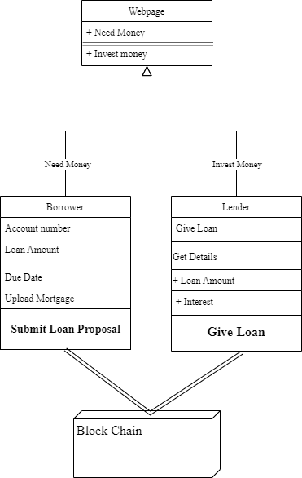
CLASS DIAGRAM

Slide 12
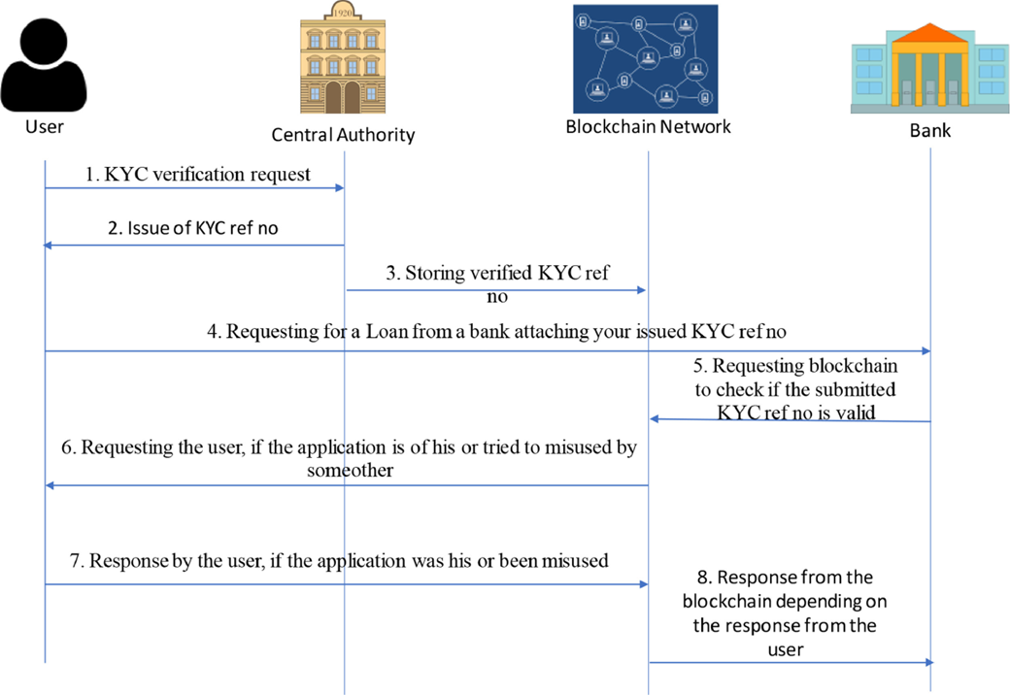
SEQUENCE DIAGRAM

Slide 13
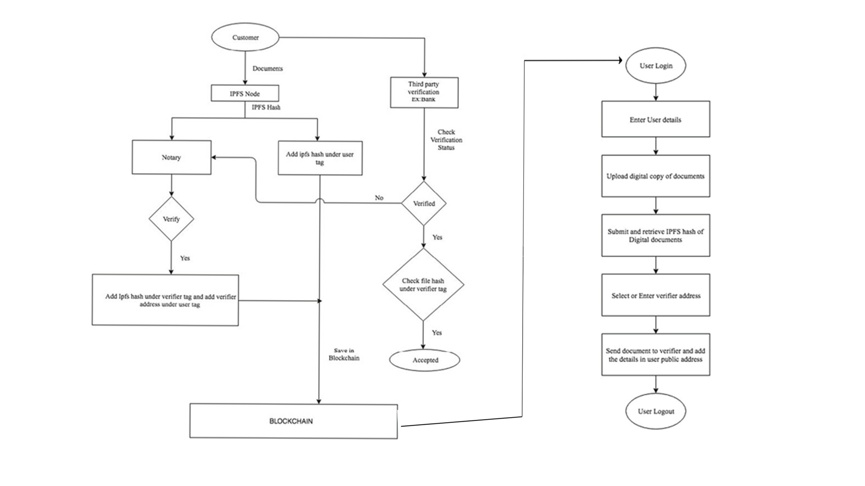
ACTIVITY DIAGRAM

Slide 14
Sample Code:
Package.json:
{
"name": "eth-todo-list",
"version": "1.0.0",
"description": "Blockchain Todo List Powered By Ethereum",
"main": "truffle-config.js",
"directories": {
"test": "test"
},
"scripts": {
"dev": "lite-server",
"test": "echo \"Error: no test specified\" && sexit 1"
},

Slide 15
"author": "gregory@dappuniversity.com",
"license": "ISC",
"devDependencies": {
"bootstrap": "4.1.3",
"chai": "^4.1.2",
"chai-as-promised": "^7.1.1",
"chai-bignumber": "^2.0.2",
"lite-server": "^2.3.0",
"nodemon": "^1.17.3",
"truffle": "5.0.2",
"truffle-contract": "3.0.6"
}
}

Slide 16
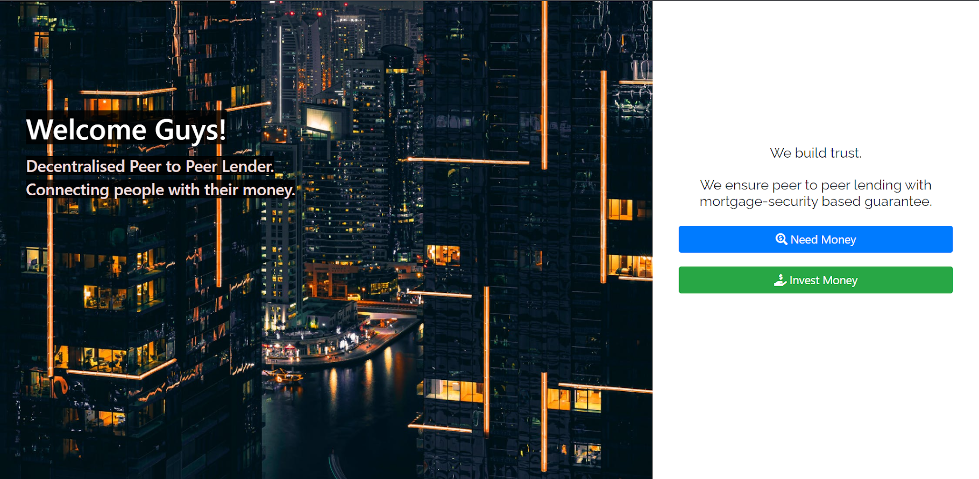
Results:
HOME PAGE

Slide 17
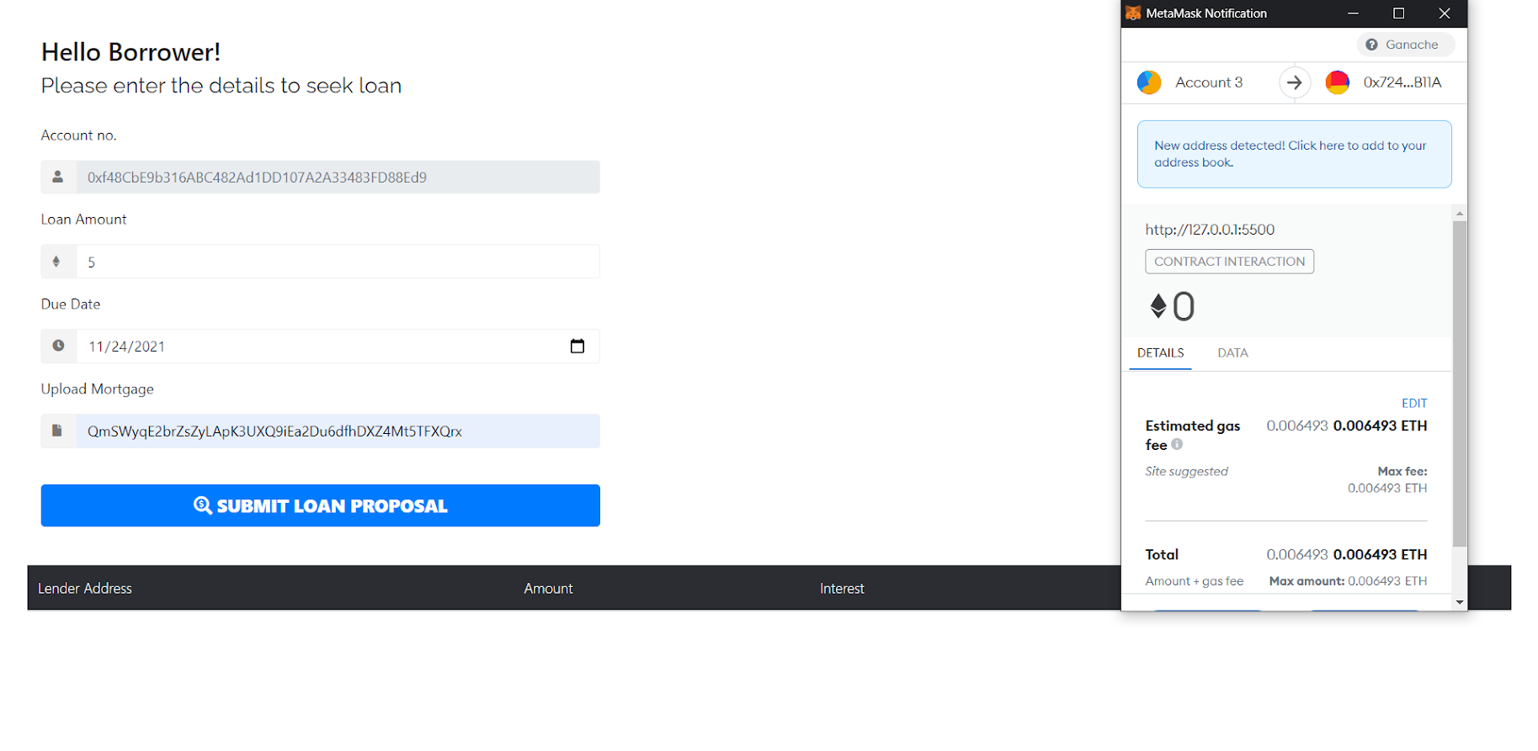
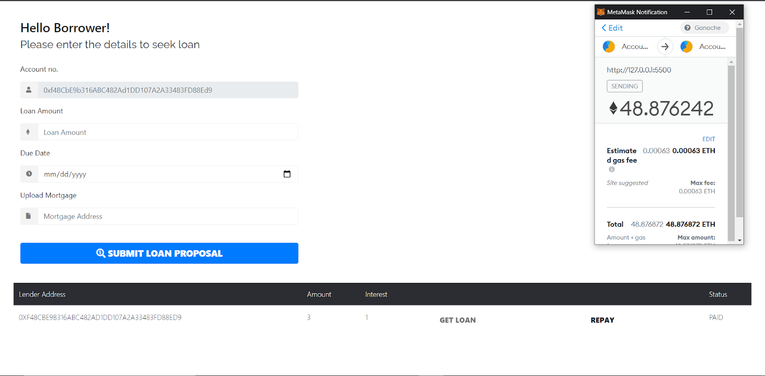
BORROWER’S PAGE

Slide 18
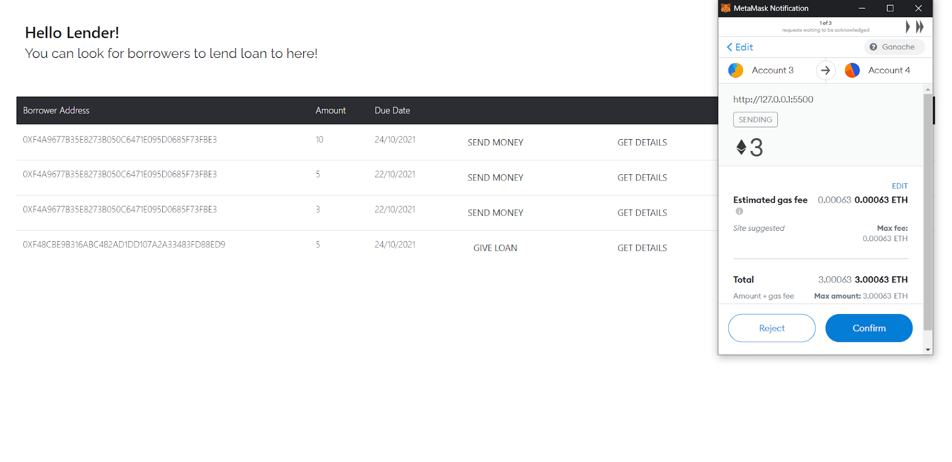
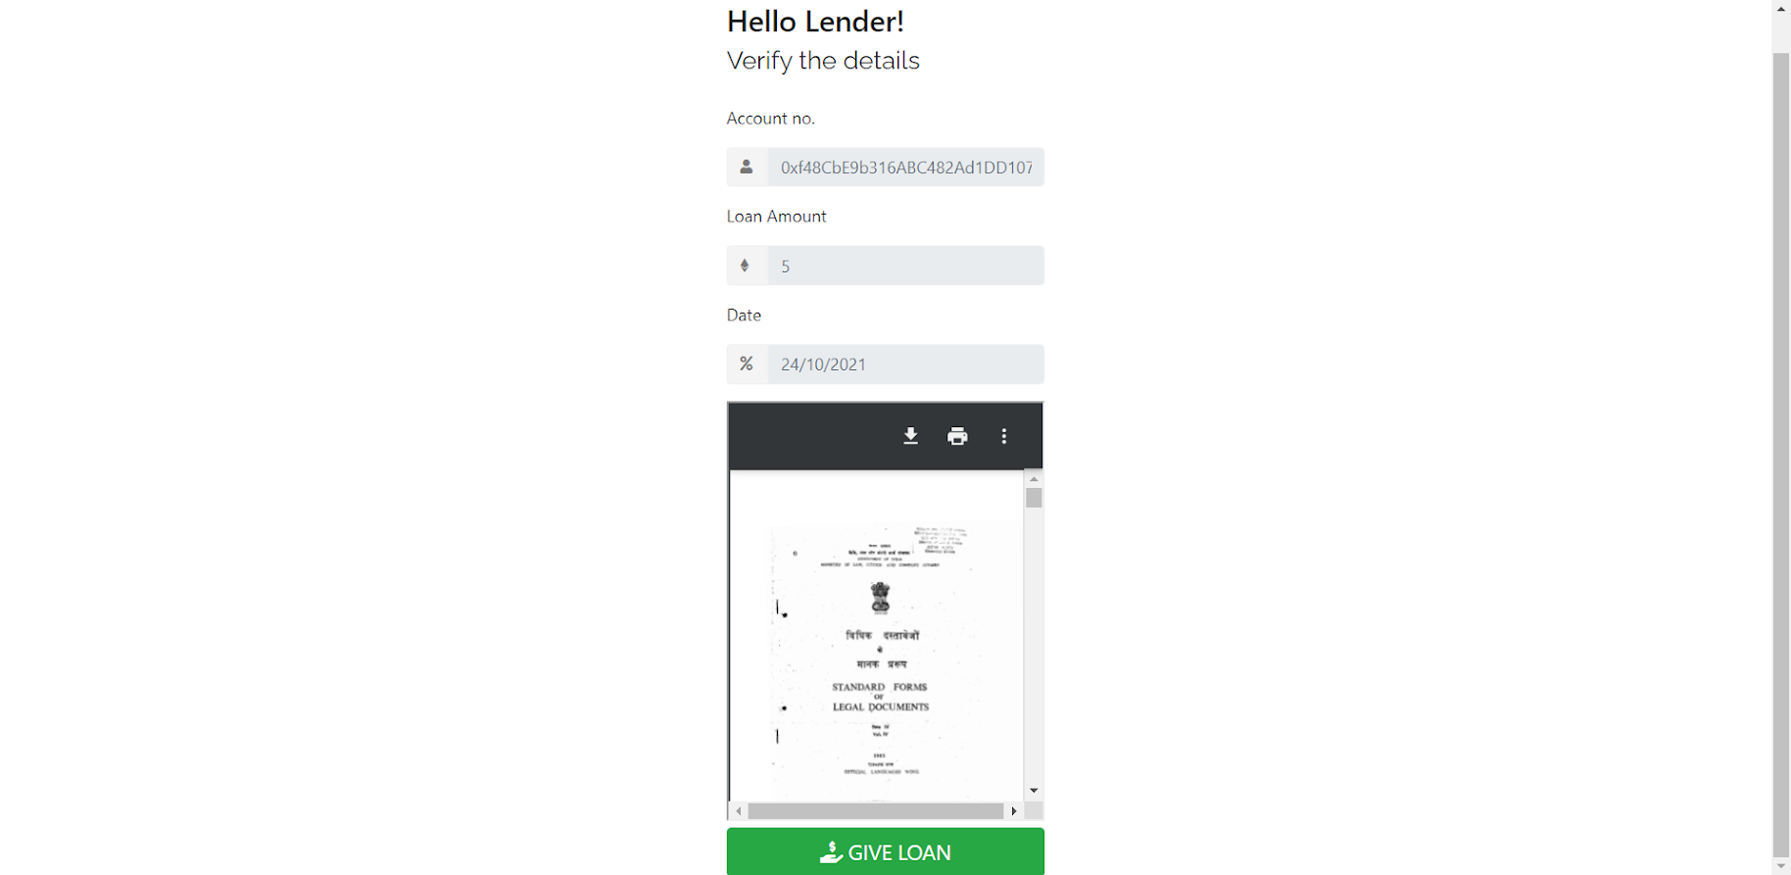
LENDER’S PAGE

Slide 19
CONCLUSION:
Microfinance is a type of banking provided to unemployed or low-income individuals or groups that would otherwise be unable to obtain financial services. Microfinance enables people to take out acceptable small business loans safely and in accordance with ethical lending principles.
When a transaction is recorded in the blockchain, details of the transaction such as price, asset, and ownership, are recorded, verified and settled within seconds across all nodes. A verified change registered on any one ledger is also simultaneously registered on all other copies of the ledger.

Slide 20
THANK YOU

